Slide 1

Delay Tolerant Networks Simulator
A simulation framework for routing in intermittently connected satellite networks
CS-576 Group 7 | December 2025
By Jordan Kelley, Antonio Toledo, Hosna Hyat, Chad Childers, Connor Symons, Maeki K, Mir Zaman Hayat

Slide 2
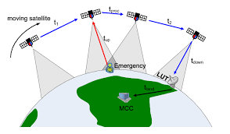
Problem Statement
Unique Constraints.
Intermittent connectivity
Propagation delays
Limited contact windows
TCP/IP protocols fail in:
Assumes always-on connectivity
Connection timeouts
end-to-end paths
Delay/Disruption Tolerant Networking (DTN)
lacks accessible tools
Notes:
Satellite networks face unique challenges that break traditional TCP/IP protocols. As satellites orbit, they move in and out of contact range, creating intermittent connectivity with delays up to several seconds.
TCP assumes always-on connections and fails when links are temporarily unavailable.
While DTN solves this through store-and-forward routing, researchers lack realistic simulators to test and compare routing algorithms under actual satellite conditions.

Slide 3
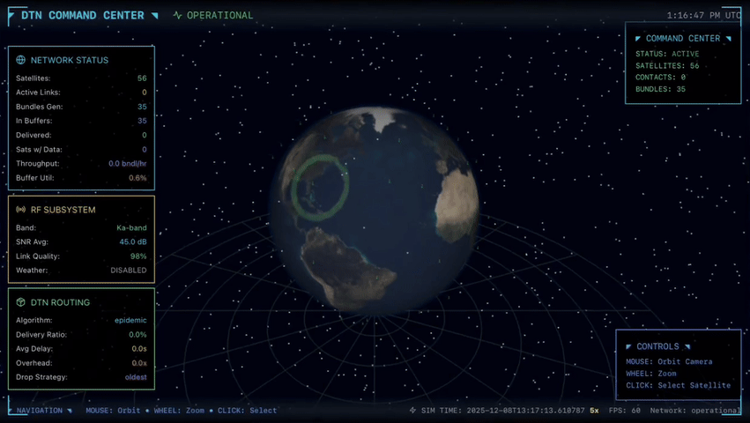
Our Solution
A realistic Earth-based DTN simulator
Performance comparison
Visualization
Real-world RF modeling
Rapid prototyping
Notes:
We built a comprehensive DTN simulator specifically for satellite constellations. It models real orbital mechanics, RF signal propagation, and atmospheric effects like rain fade.
Researchers can upload custom satellite configurations via CSV, compare routing protocol performance, and rapidly prototype new algorithms.
The 3D visualization and 3600x time acceleration let users observe days of network behavior in minutes, making it a practical tool for satellite network research.

Slide 4
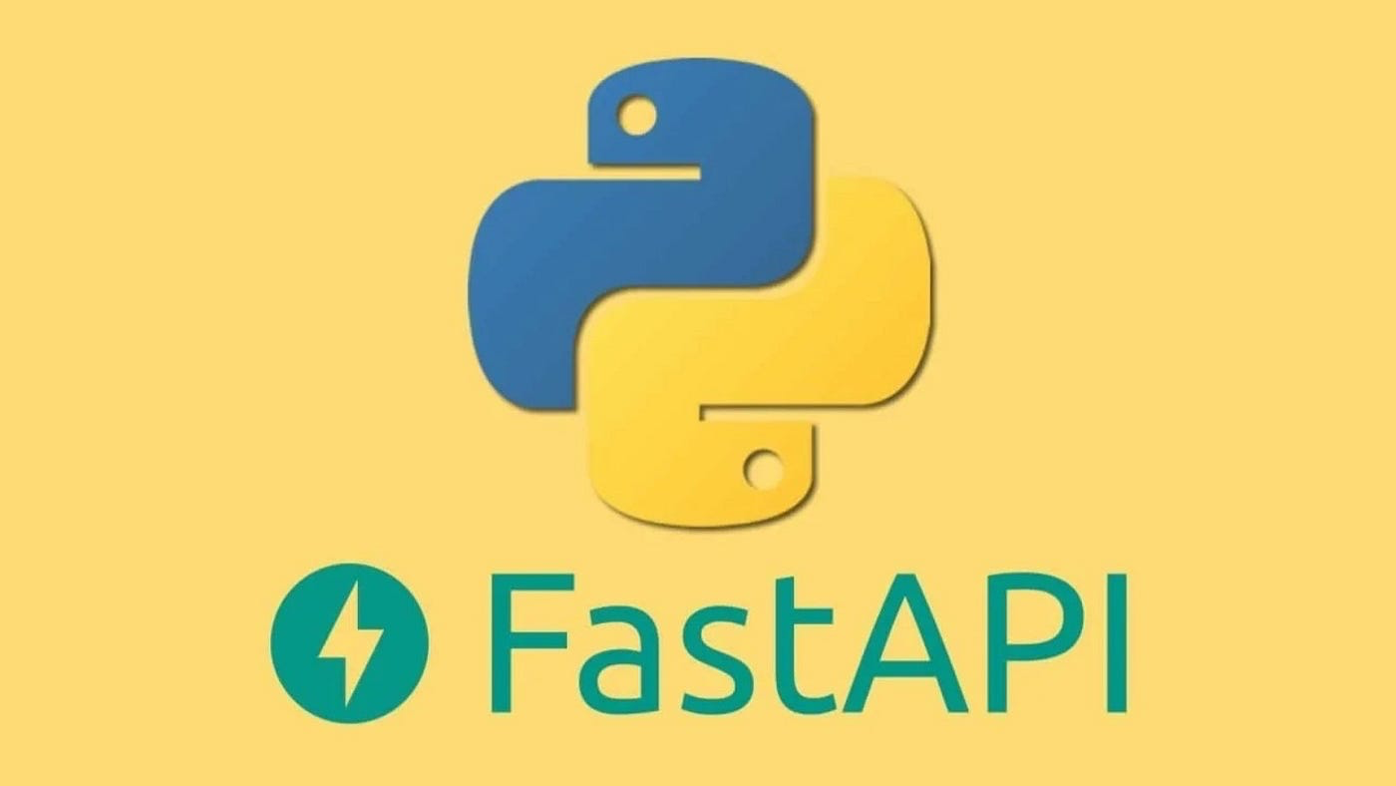

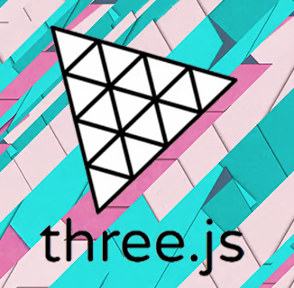
Solution Architecture
Backend (FastAPI): RF modeling & link budget calculations
Frontend (React + Three.js): 3D satellite visualization & UI
Routing Engine: Epidemic, PRoPHET, Spray-and-Wait protocols
Modular design for extensibility
Notes:
Our architecture is organized into four key components.
The backend, built with Python FastAPI, handles all the simulation physics - RF modeling that calculates signal strength between satellites and comprehensive link budget analysis to determine when communication is possible.
The frontend uses React for the user interface combined with Three.js for 3D satellite visualization, giving users an intuitive view of their constellation and real-time connectivity status as satellites orbit.
Our routing engine implements three DTN protocols: Epidemic, which floods messages across the network; PRoPHET, which uses probabilistic routing based on contact patterns; and Spray-and-Wait, which intelligently limits message copies to reduce network overhead.
The modular design ensures extensibility - researchers can easily add new routing algorithms or modify existing ones without overhauling the entire system.

Slide 5

DEMO

Slide 6
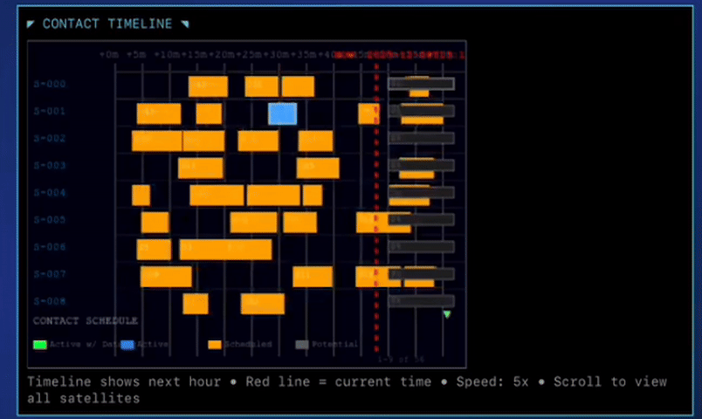
Implemented Features
Network & Physical Layer
Bundle protocol
RF link modeling
Contact capacity & window duration
Routing Algorithms
Epidemic, PRoPHET, Spray-and-Wait
Buffer Management
Configurable sizes
Orbital Mechanics
Keplerian propagation
Contact window prediction
Notes:
Our simulator models realistic DTN communication—bundles have TTLs and unique IDs, links account for RF propagation including weather effects, and we implemented three routing protocols: Epidemic, PRoPHET, and Spray-and-Wait. Orbital mechanics drive contact windows using real Keplerian propagation.

Slide 7
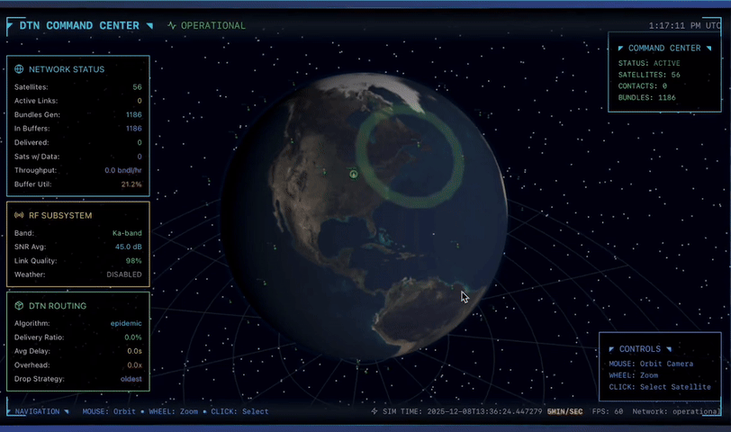
Implemented Features Cont.
3D Interactive GUI
satellite constellation
Animated packet transfers
Contact Gantt charts and utilization bars
Ground station markers, run controls
Live Metrics
Delivery ratio, throughput, buffer utilization
Experiment Framework
E1: Protocol comparison | E2: Buffer size sweeps | E3: TTL configuration
Preset endpoints
Notes:
The GUI provides a 3D Earth view with live satellite positions and animated packet transfers. You can see buffer utilization, contact schedules via Gantt charts, and key metrics like delivery ratio. Our experiment framework lets you compare protocols, sweep buffer sizes, and test TTL configurations.

Slide 8


Limitations
Scope Constraints
Satellite-only focus (no terrestrial wireless/BLE/Wi-Fi)
Orbital mechanics only (no random waypoint mobility)
ISL routing implemented but visualization removed
Incomplete Features
Contact plan CSV upload endpoint (not integrated)
Mid-run plan changes (limited testing)
Custody timer resume after partition healing
Visualization Gaps
Delay CDF calculated but not displayed
Overhead ratio computed but not prominent
Basic metrics only (no confidence intervals)
Node scaling experiments (manual, not automated)
Notes:
Key limitations include our satellite-only scope, which excludes terrestrial wireless networks. While the backend calculates many metrics, some aren't exposed in the UI.
Inter-satellite link routing works but we removed its visualization to keep the interface clean and focused.

Slide 9
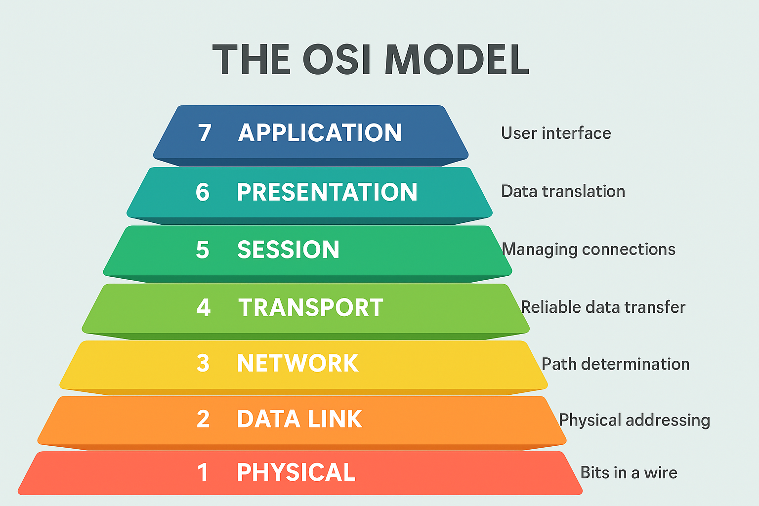
OSI Model Implementation
L7: REST API, simulation framework, experiment tools,
L6: Bundle serialization, JSON encoding, Pydantic models
L5: Contact window management, predictive scheduling
L4: Bundle Protocol with lifetime, priority, custody flags
L3: Epidemic, PRoPHET, Spray-and-Wait routing with DTN addressing (EIDs)
L2: Store-and-forward frames, contact-based transmission
L1: RF link budget modeling, frequency bands, weather effects (all simulated)
Notes:
Starting from the top — Layer 7 provides our REST API and experiment framework. Layer 6 handles bundle serialization using JSON and Pydantic models.
Layer 5 manages contact windows and predictive scheduling based on orbital mechanics. Layer 4 implements the Bundle Protocol with lifetime, priority, and custody transfer flags. Layer 3 is where our three routing algorithms live — Epidemic, PRoPHET, and Spray-and-Wait — using DTN endpoint identifiers. Layer 2 handles store-and-forward and contact-based transmission. Layer 1 models RF link budgets, frequency bands, and weather effects, though it's all simulated rather than actual bit transmission.

Slide 10

Abstractions
Network Protocols
No explicit MAC layer or handshake overhead
Simplified custody transfer (no acceptance/refusal messages)
No bundle fragmentation or reassembly
Discovery & Routing
Contacts from orbital prediction, not dynamic discovery
Generic data rates (no BLE/Wi-Fi profiles)
Deterministic orbital mechanics vs. community mobility
Data Handling
Bundles as atomic units
Implicit duplicate suppression via ID tracking
Notes:
Our simulator abstracts several DTN features to focus on core routing behavior. We use deterministic orbital mechanics instead of dynamic discovery protocols, treat bundles as atomic units without fragmentation, and simplify custody transfers. This keeps the simulation tractable while preserving the essential store-and-forward characteristics we're studying.

Slide 11
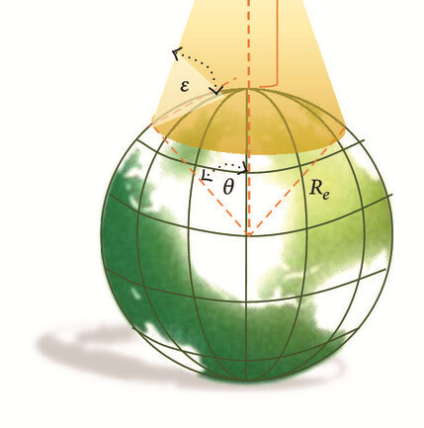
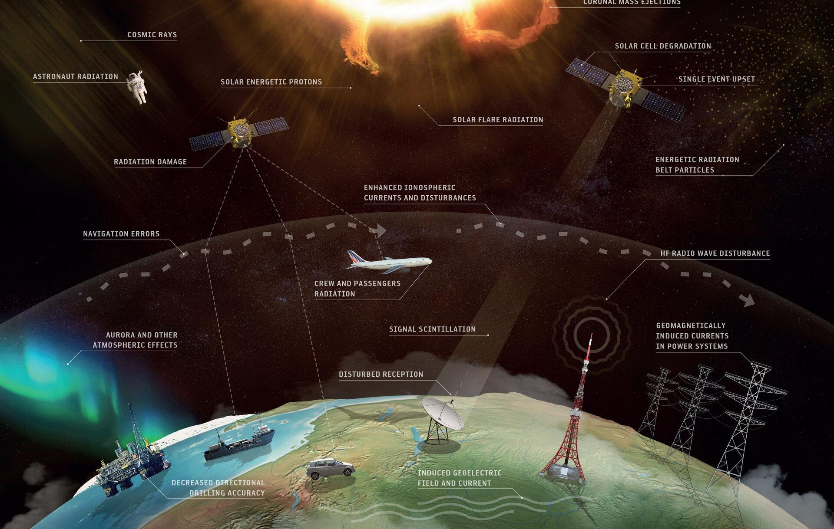
Practical Applications
• Educational tool for teaching DTN and satellite networking concepts
• DTN routing algorithm research and comparison
• Satellite constellation design optimization
• Ground station placement analysis
• Weather impact studies on satellite communications
Notes:
From a research perspective, this tool enables direct comparison of DTN routing protocols under realistic conditions. You could use it to test new constellation configurations, evaluate where to place ground stations for best coverage, or study how weather degrades link quality, all without needing actual satellites.

Slide 12

Future Work
• Add MaxProp, RAPID routing algorithms
• Security features (bundle encryption, authentication)
• Mobile ground stations
• Machine learning-based routing optimization
• VR visualization interface
• Real hardware/tracking system integration
Notes:
For future work, we'd add more routing algorithms like MaxProp and RAPID. Security features like encryption would be important for real-world use. Longer term, we could integrate machine learning for smarter routing decisions, support mobile ground stations, or even connect to real satellite tracking systems.

Slide 13

Thank You!

